Slide 1
Experiential Learning in Vietnam
A Teaching Method to Foster Students' Character and Competencies

Slide 2
Introduction
Experiential learning = method & philosophy
Learners participate, explore, reflect
Inspired by Dewey, Piaget, Vygotsky
Supports Vietnam’s education reform

Slide 3
What is Experiential Learning?
Learning through real-life contexts
Students apply knowledge & skills
Encourages critical thinking & creativity
Assessment: process + outcomes + growth

Slide 4
Why It Matters in Vietnam
Supports education program goals
Character: autonomy, honesty, compassion
Competency: collaboration, creativity, communication

Slide 5
Models of Experiential Learning
Extracurricular: field trips, clubs, life skills
Project-based: tree planting, art projects
STEM/STEAM: experiments, product design
Career experiences: internships, enterprise visits

Slide 6
Benefits for Students
Proactive & confident learners
Improved teamwork & collaboration
Better problem-solving & creative thinking
Comprehensive growth in knowledge, skills, attitudes

Slide 7
Challenges
Limited awareness (teachers & parents)
Insufficient facilities & resources
Lack of consistent guidelines
Difficulties assessing competencies & soft skills

Slide 8
Character Development
Responsibility, discipline, honesty
Cooperation, compassion, empathy
Confidence, perseverance, resilience

Slide 9
Competency Development
Problem-solving & critical thinking
Creativity & innovation
Communication & teamwork
Technology use & adaptability

Slide 10
Social Connection
Links schools, families, communities
Students join local & cultural projects
Learn civic responsibility & heritage
Foundation for lifelong learning & integration

Slide 11
Roles of Teachers
Designers of real-life activities
Companions & co-learners
Guides in reflection & responsibility
Bridge between theory & practice

Slide 12
Roles of Schools
Build culture of experiential learning
Provide safe & supportive environments
Invest in facilities & diverse programs
Help students discover passion & potential

Slide 13
Roles of Parents
Encourage participation in activities
Cooperate with schools
Provide resources & guidance
Strengthen family bonds & child development

Slide 14
Measures to Enhance Effectiveness
Teacher training: project/problem-based learning
Innovative assessment: portfolios, rubrics
Partnerships: businesses, NGOs, museums
Infrastructure & resources: flexible scheduling
Student voice: co-design activities
Policy support & monitoring

Slide 15
Conclusion
Experiential learning = modern education trend
Fosters qualities & competencies
Requires collaboration: teachers, schools, parents
Prepares students for 21st-century global challenges

Slide 16
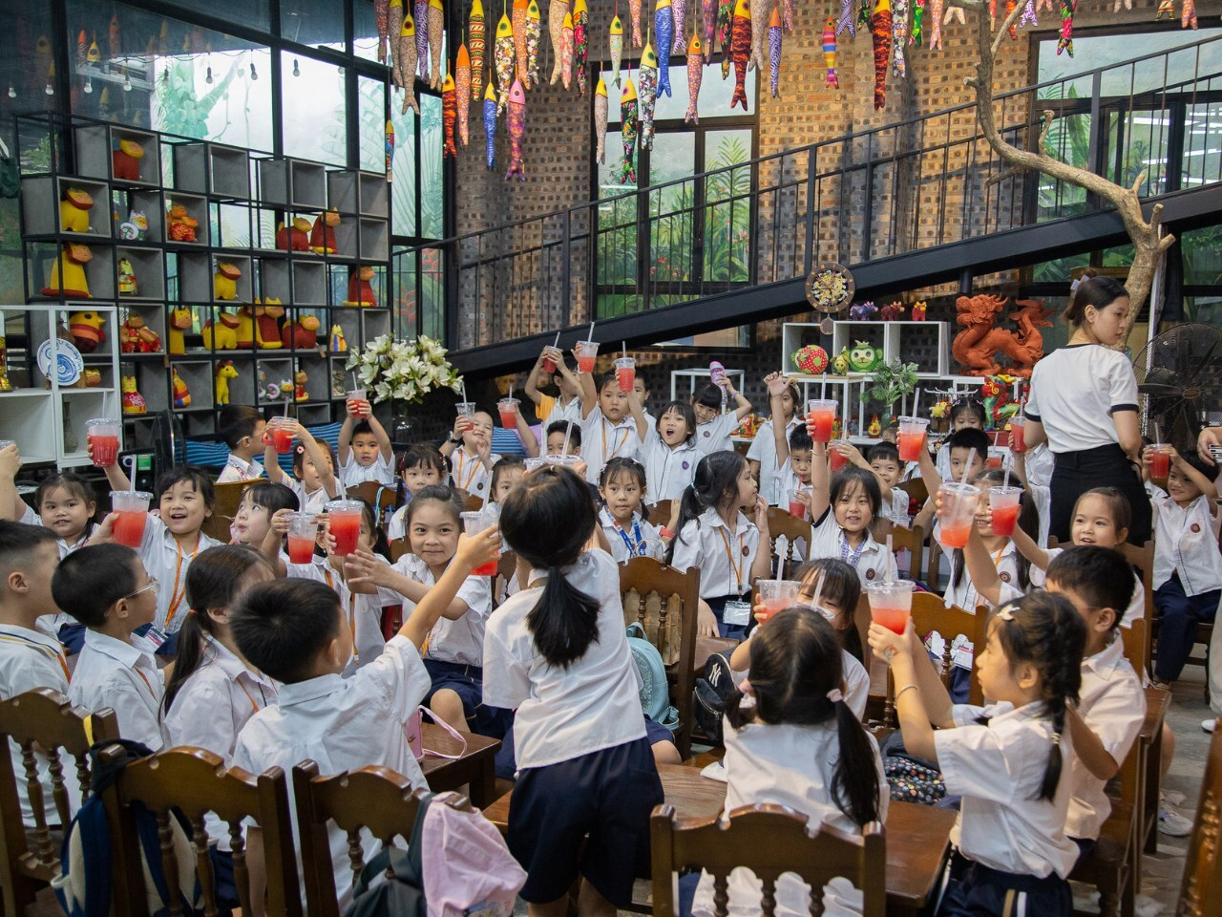
Children having fun during a school trip

Slide 17

A field trip to historical sites

Slide 18
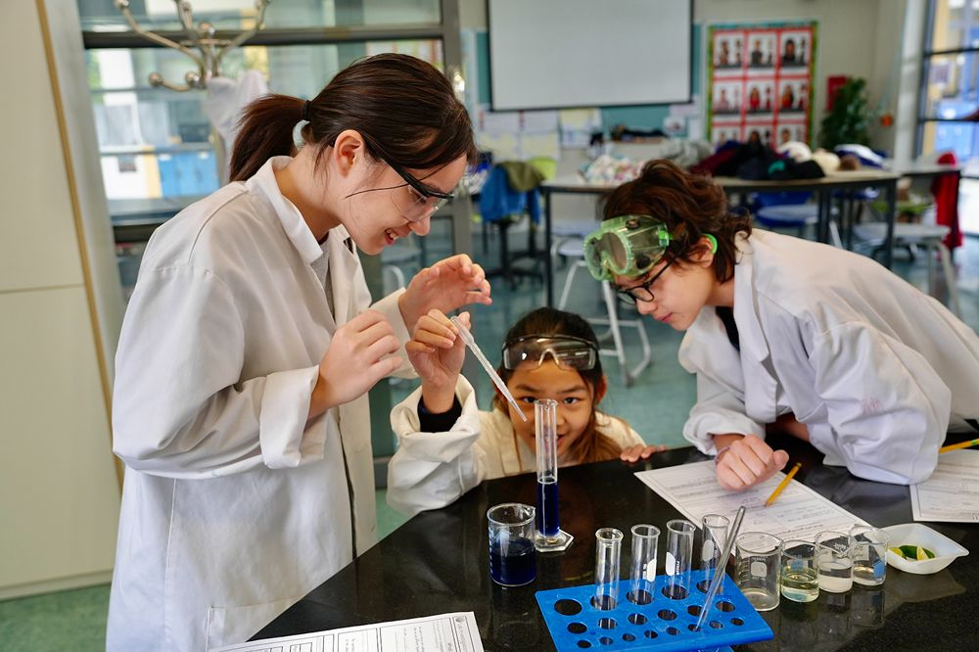
Working in lab

Slide 19
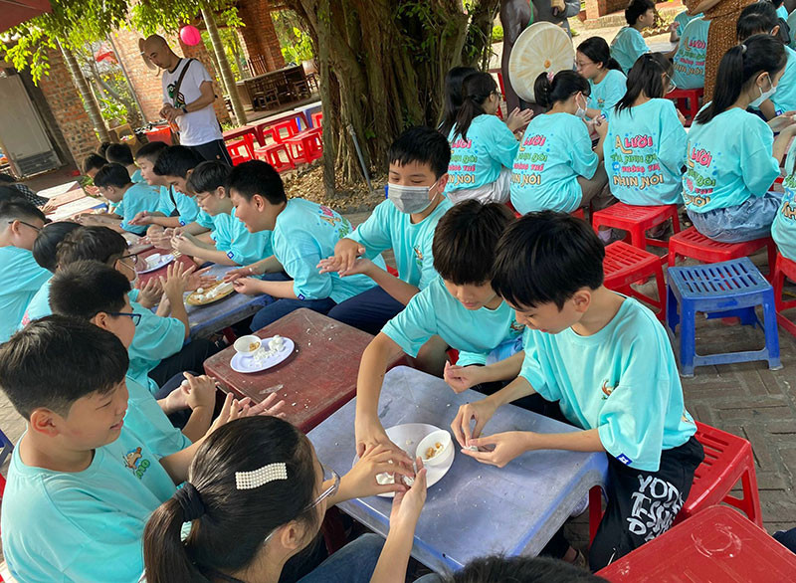
Learning to make traditional dish for
Cold Food Festival

Slide 20
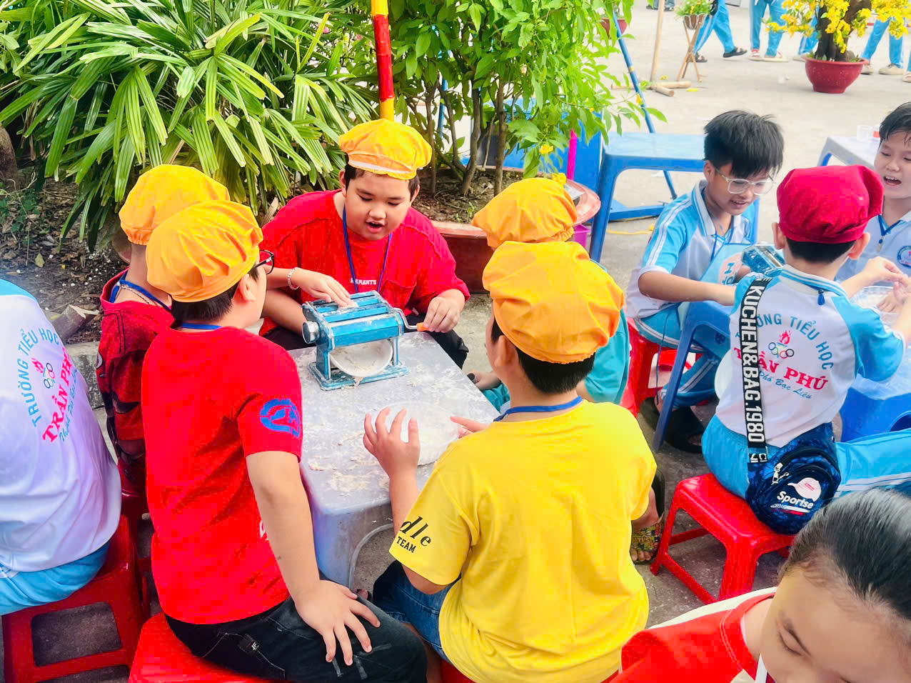
Little chefs making pasta for school meals

Slide 21
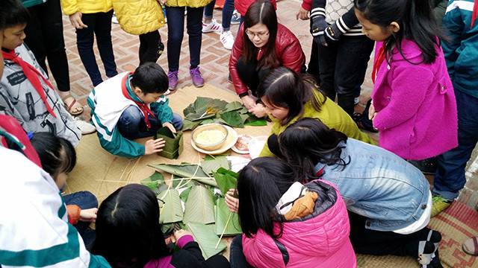
Teachers showing children how to make "Banh Chung -traditional sticky rice dish" for Lunar New Year Festival

Slide 22
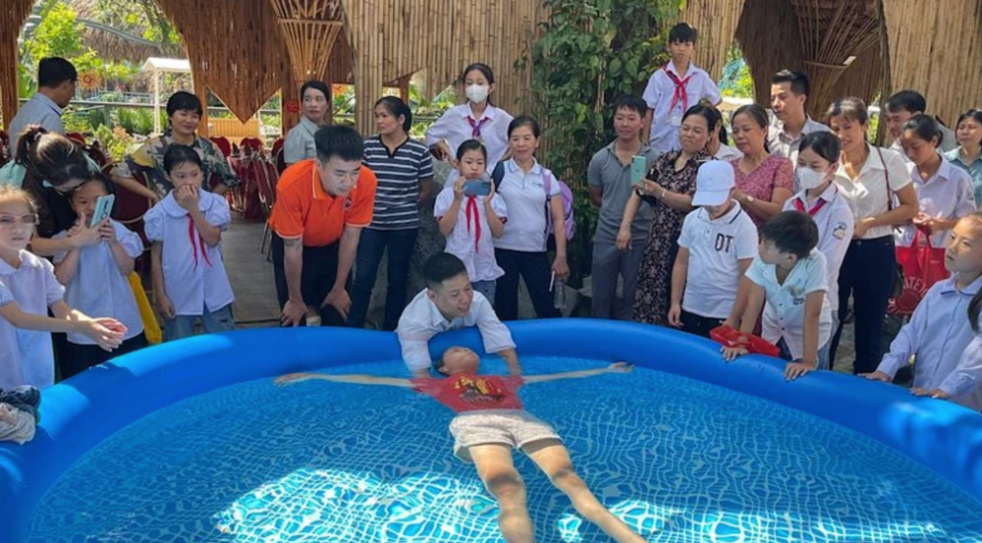
Learning by practising

Slide 23
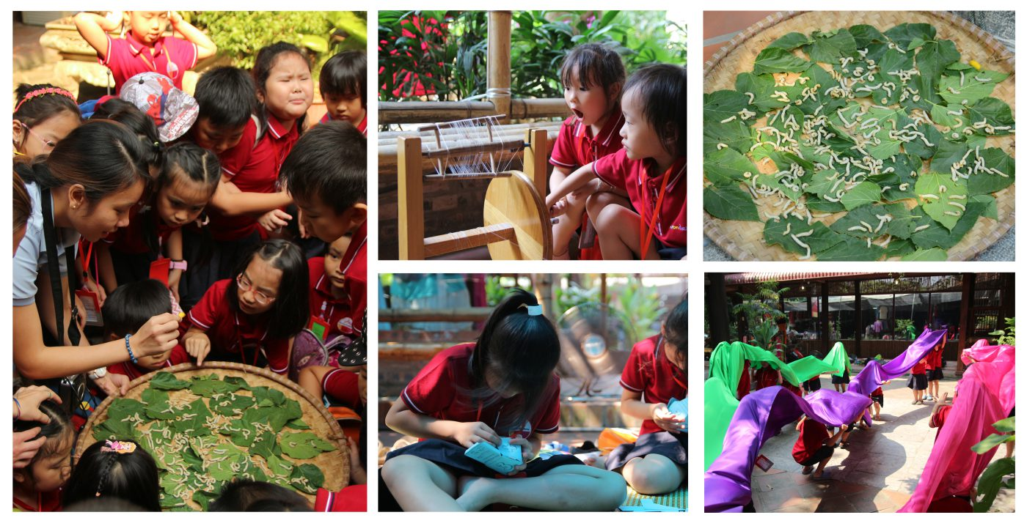
A day out to Van Phuc Silk Village to learn from artisans about mulberry worm life cycle and how to weave silk thread and how to dye silk cloth

