Slide 1




39th ASEAN Council of Teachers + Korea (ACT+1) Convention 2025
1946 – 2026
Educators – Humanising Education Amidst Rapidly Changing Landscapes
Singapore Country Report

Slide 2

Defining Humanising Education
  Learner-centred, empathetic, inclusive
  Focus on whole-person development
  Beyond academics: emotional, social, ethical growth
“In order for learning to personalised, it needs to be humanising.”
1946 – 2026
Singapore Country Report

Slide 3
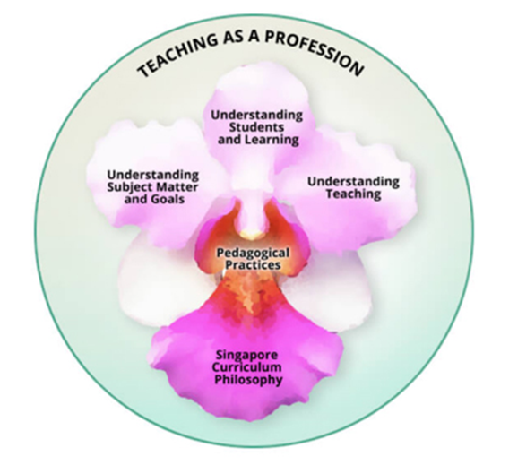
Frameworks Supporting Humanising Education
Singapore Teaching Practice (STP)
Reflective Practice, Positive Relationships
1946 – 2026
Singapore Country Report

Slide 4
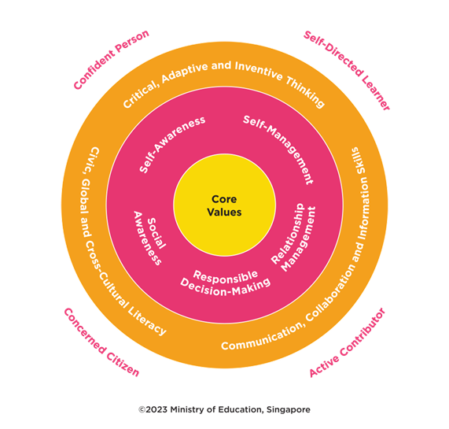
Frameworks Supporting Humanising Education
21CC Framework
Core values, SEL, emerging competencies
1946 – 2026
Singapore Country Report

Slide 5
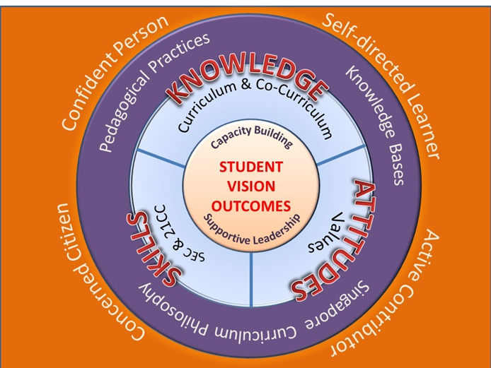
Frameworks Supporting Humanising Education
Desired Outcomes of Education (DOE)
Confident, self-directed, active, and concerned citizens
1946 – 2026
Singapore Country Report

Slide 6
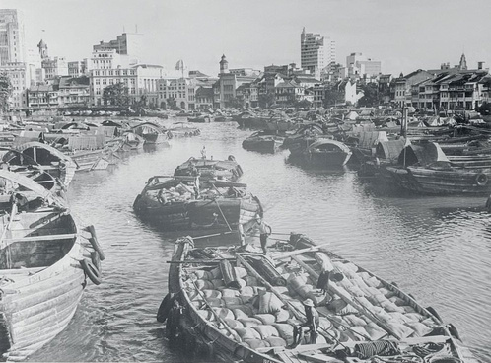
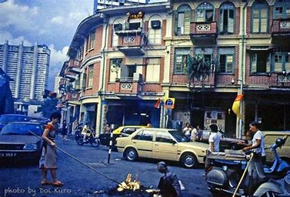
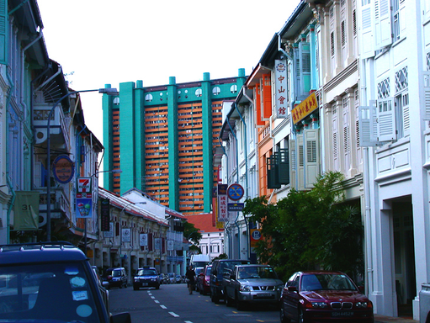

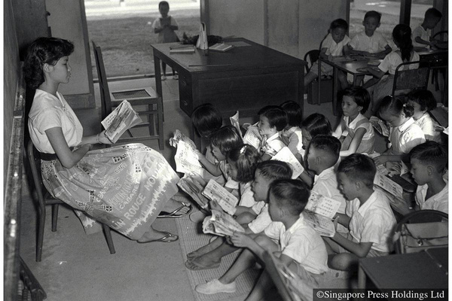
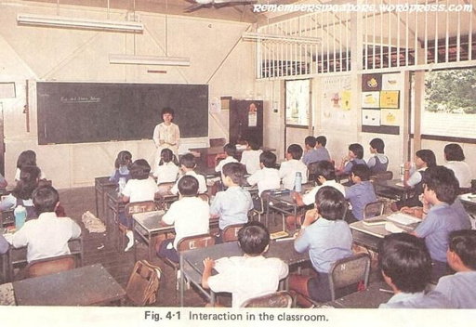
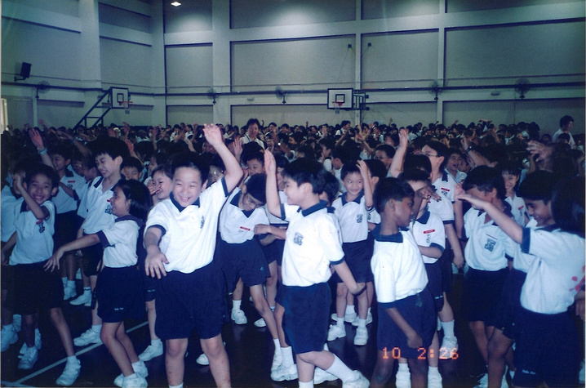
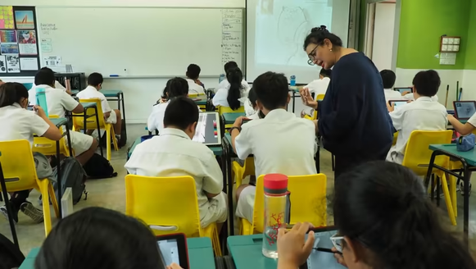
Policy Evolution Timeline
1959 - 1978
Survival Driven
1976 - 1996
EFFICIENCY DRIVEN
1997 - 2011
Ability Based,
Aspiration Driven
2011 - 2025
Student-Centric, Values Based
1946 – 2026
Singapore Country Report

Slide 7

Educators as Agents of Humanisation
  Teachers as mentors, not just content deliverers
  Personalised learning, inclusive classrooms
  Modelling values, supporting SEL
1946 – 2026
Singapore Country Report

Slide 8

Supporting Educators – STU's Role
  Teacher wellness programmes
  Peer support networks
  Advocacy for protected rest time and fair workload
1946 – 2026
Singapore Country Report

Slide 9
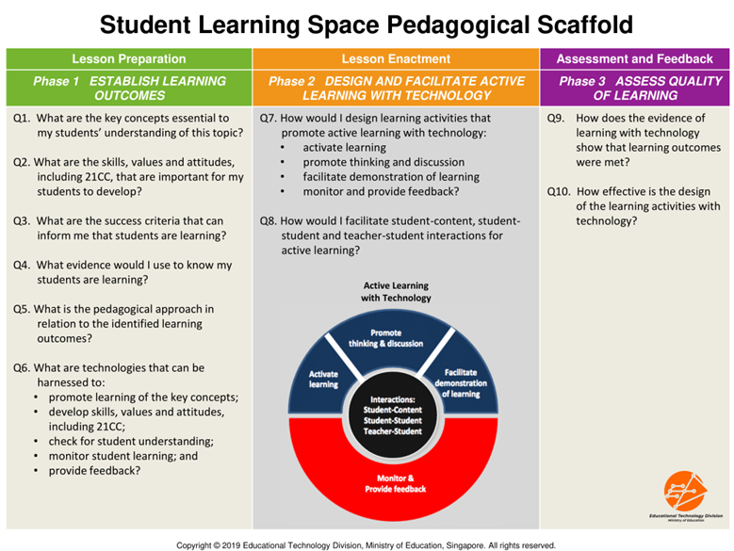
Technology and Humanisation
Student Learning Space (SLS):
Blended learning
1946 – 2026
Singapore Country Report

Slide 10
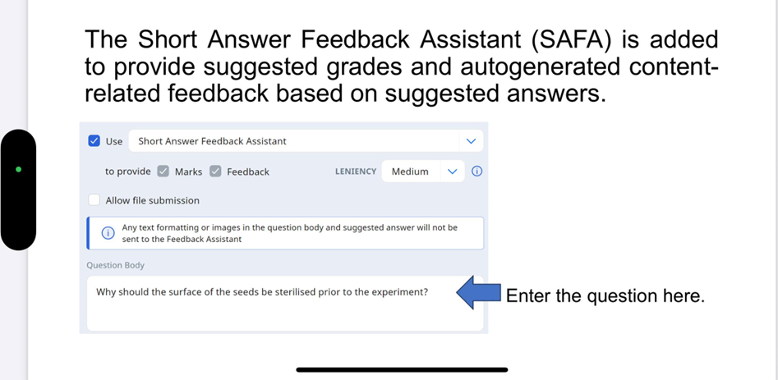
Technology and Humanisation
AI Tools: Feedback, lesson adaptation
1946 – 2026
Singapore Country Report

Slide 11
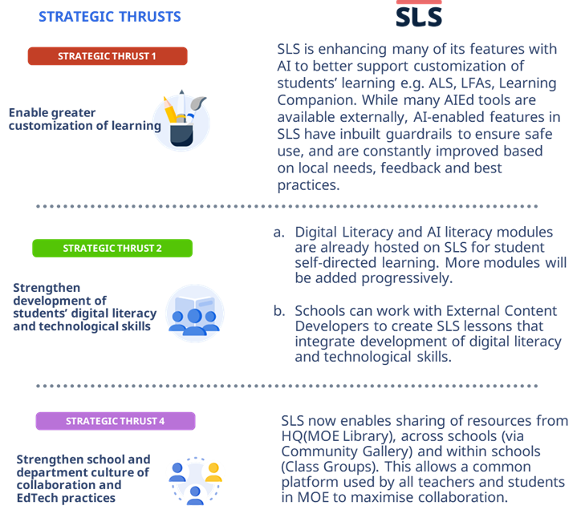
Technology and Humanisation
EdTech Masterplan 2030:
Digital skills, human-centric tech use
1946 – 2026
Singapore Country Report

Slide 12

Challenges
Balancing academic rigour and well-being
1946 – 2026
Singapore Country Report

Slide 13

Challenges
Teacher workload and retention
1946 – 2026
Singapore Country Report

Slide 14

Challenges
Equity and inclusion for diverse learners
1946 – 2026
Singapore Country Report

Slide 15
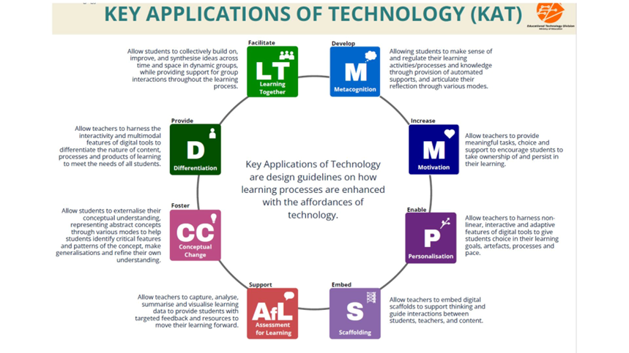
Challenges
AI & EdTech for personalisation and admin support
1946 – 2026
Singapore Country Report

Slide 16
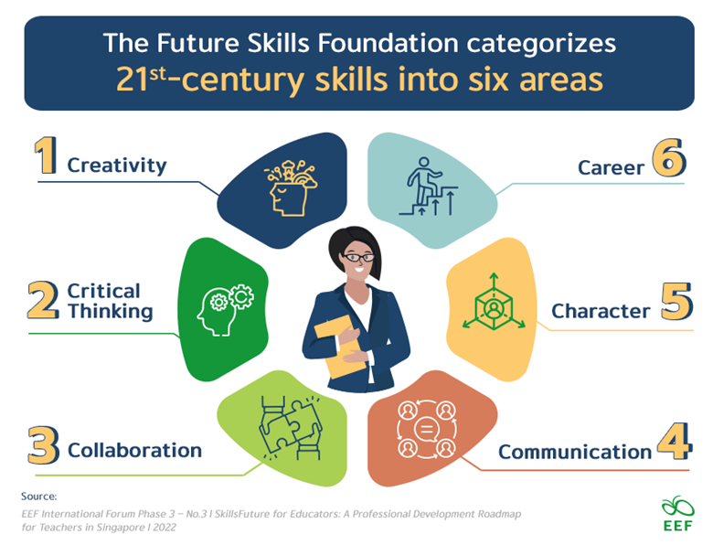
Opportunities Ahead
Deeper professional development and career pathways
1946 – 2026
Singapore Country Report

Slide 17
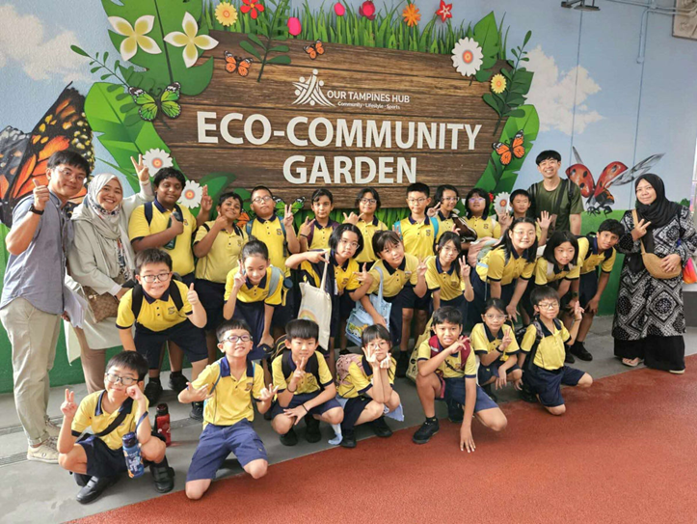
Opportunities Ahead
Whole-of-society partnerships (families, industry, community)
1946 – 2026
Singapore Country Report

Slide 18

Conclusion
Singapore’s commitment to humanising education
1946 – 2026
Singapore Country Report

Slide 19

Conclusion
Teachers at the heart of transformation
1946 – 2026
Singapore Country Report

Slide 20

Conclusion
Preparing learners to lead, care, and thrive
1946 – 2026
Singapore Country Report

Slide 21

Questions & Answers
1946 – 2026
Singapore Country Report

Slide 22
Thank You!
1946 – 2026

