Slide 1
AI-Powered Education
The 39th ASEAN Council of Teachers +Korea
Presenter: ChangYong Sim, KFTA

Slide 2
Machine Learning vs. Deep Learning
Developer Area
Computer Learning Area
Input
Feature extraction
Classification
Output
Computer Learning Area
Input
Feature extraction
Output

Slide 3
AIDT?
Learning Analytics
-learning diagnostics and analytics)
Adaptive Learning
- personalized learning that reflects each student's level and pace
Human-Centered Design
-learning courseware designed from the student's perspective

Slide 4

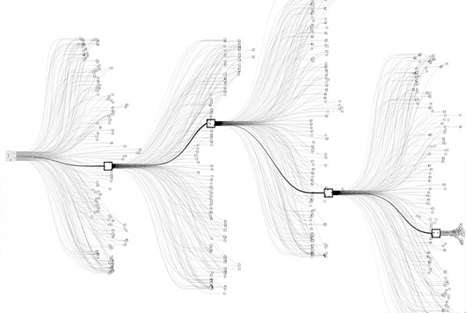
Personalized training with AI
There are various indicators in the learning path.
AI identifies gaps and provides optimal learning paths.
Students can learn their own customized learning with the optimal learning path provided by AI.
출처 : https://brunch.co.kr/@nascar7/3

Slide 5
AI Digital Textbook Key Features
Analyze student learning data
For students, it supports personalized learning by recommending the best learning path and content as an AI tutor.
For teachers, it assists in data-driven learning management, such as assisting with lesson design and restructuring and adding learning content as an AI assistant.
Supplementary learning for slow learners and in-depth learning for fast learners to create a customized learning environment
Lesson innovation to determine the teaching method and level considering learning readiness and the characteristics of each unit
Social-emotional guidance that observes students' participation and interest trends through dashboard materials, etc., and provides emotional counseling and career counseling when necessary.
Data-driven student assessment

Slide 6
AI Digital Textbooks
AI digital textbooks aim to create a personalized learning environment by providing learning objectives and tasks that consider students' academic achievement levels and interests.
By analyzing student learning data, the system supports personalized learning by recommending optimal learning paths and content to students as an AI tutor and assists teachers as an AI teaching assistant by supporting lesson planning, restructuring and supplementing learning materials, and managing learning based on data.

Slide 7
AI Tutors and AI Assistants
AI Tutor: Features to Support Students' Learning
AI Assistants: Features to Support Teacher's Lesson

Slide 8
Application Areas of the AI Tutor (Yoo Mina et al., 2023)
Domain | Role
Cognitive Domain | Tutor | Direct instruction | - Presentation of learning objectives for each session - Provision of learning overviews for goal achievement - Summary materials of learning content
 | Coach | Promotion of metacognition | - Motivational prompts to encourage learning participation - Advice or help with learning activities
 | Mentor | Provision of feedback | - Presentation of learning monitoring information and participation levels - Tools for learning journals and self-assessment
Affective Domain | Coach |  | - Delivery of motivational messages
 | Mentor |  | - Praise or encouragement for learning outcomes
 | Tool |  | - Tool for expressing personal emotions
Social Domain | Team Member | Enhancement of team performance | - Tool for social interaction with other learners
 | Tool | Execution of tasks | - Tool for connecting with external experts

Slide 9
Main Functions of the AI Tutor and AI Teaching Assistant
 | Function | Description
AI Tutor | Q&A | Responds immediately to students’ questions.
 | Provision of Supplementary Materials | Offers additional resources for concepts that are difficult to understand or require further explanation. Provides elaborations, practice problems, and recommended materials to reinforce learning.
 | Learning Strategy Suggestions | Suggests personalized strategies based on the student’s level and goals. Analyzes learning process and outcomes to assess achievement, identify strengths and weaknesses, and provide tailored guidance.
 | Progress Monitoring | Tracks learning progress against plans. Provides information to help improve performance and participation by analyzing key indicators from individual learning activities.
 | Feedback and Achievement Assessment | Offers timely feedback and a to-do list based on progress analysis. Provides achievement evaluations and guides further learning through data-driven recommendations.
 | Error Note Provision | Analyzes incorrectly answered questions and explains errors. Creates and accumulates an error log throughout the learning process, allowing students to review and address weaknesses over time.

Slide 10
Main Functions of the AI Tutor and AI Teaching Assistant
Category | Function | Description
AI Teaching Assistant | Lesson Planning Support | Analyzes curriculum content and student achievement levels to recommend personalized lessons and suggest appropriate content and question items.
 | Feedback Design Support | Provides teachers with feedback sentences based on analysis of student activities and allows customization of the suggested
 | Assessment Support | Supports grading and provides a visual summary of student performance for the teacher.
 | Student Monitoring Support | Monitors students’ use of the AI digital textbook and notifies teachers about progress or issues during learning.

Slide 11
The Essence of Education
Strengthening concept-oriented and problem-solving-oriented education to foster unique human creativity, critical thinking, personality, and collaboration skills that AI cannot replace
Implement a system in which all students receive customized education that suits their learning goals, learning capabilities, and learning speed, and in which teachers and students are humanly connected.
출처 : 디지털 기반 교육혁신 방안(2023. 2.)

Slide 12
The Role of Teachers
Based on the analysis of the AI tutor, it conducts lessons tailored to the individual characteristics of students and plays a role in bringing out the best in students' abilities.
Along with learning design that can maximize individual student learning performance, stable counseling and mentoring are provided by observing and diagnosing social and emotional changes.
출처 : 디지털 기반 교육혁신 방안(2023. 2.)

Slide 13
Important!
AIDT is a good class tool if used well (Immediate and Individual Feedback)
How to use it in class is important.
Preparation-Learning-Review
Flipped Learning
Blended Learning

Slide 14
Digital Instruction· Learning and Assessment
Traditional Approach
Assessment based Approach
Eclectic/Selective Approach

Slide 15
Traditional teaching and learning model
KEDI Teaching and Learning Design Model (Korea Institute for Educational Development, 2023)
Comprehensive lesson design and operation plan including teaching methods
and strategies, teaching and learning activities, etc.
1. Classes and Learner Analytics
2. Determine the teaching method
3. Determine your teaching strategy
4. Select AIDT-based teaching and learning activities
5. Personalized lessons Model Development
Lesson objectives, learning content, Demands, Learner Analysis Utilize → dashboards
Lecture (knowledge transfer) type Problem-solving, hands-on Cooperative learning type, etc.
Motivation, Understanding Enhancement, Participation promotion, interaction strategies, etc.
Matrix Utilization Lessons AI-powered to do step by step Teaching and Learning Activity Selection
Teachers can use their own lessons Powered by the right AI DT Lesson Model Development
The 5 stages of the KEDI Teaching Design Model [Source: Korea Institute for Educational Development (2023)]

Slide 16
Assessment-Centered Teaching-Learning Model
the curriculum based on Backward Design(Wiggins & McTighe, 2005)
Develop evaluation tasks or implementation tasks first,
and then develop teaching and learning processes.
Assessment is the center,
and the development of assessment tasks is the beginning of lesson design
Assessments are conducted to confirm that learners have understood the key learning content
corresponding to the learning objectives
Organize learning activities after the assessment content is set
so that the curriculum, classes, and assessments are closely linked.

Slide 17
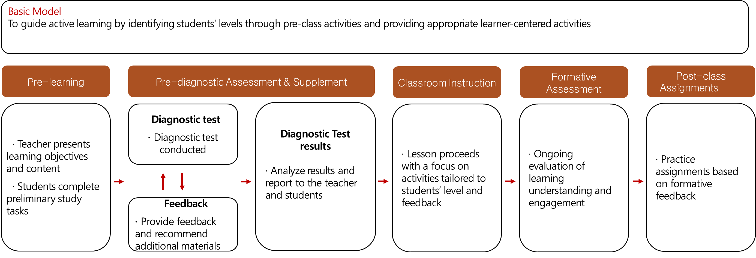
Concept-Based Inquiry Lesson Design Model Using AI Digital Textbooks
(Ministry of Education, 2024)

Slide 18
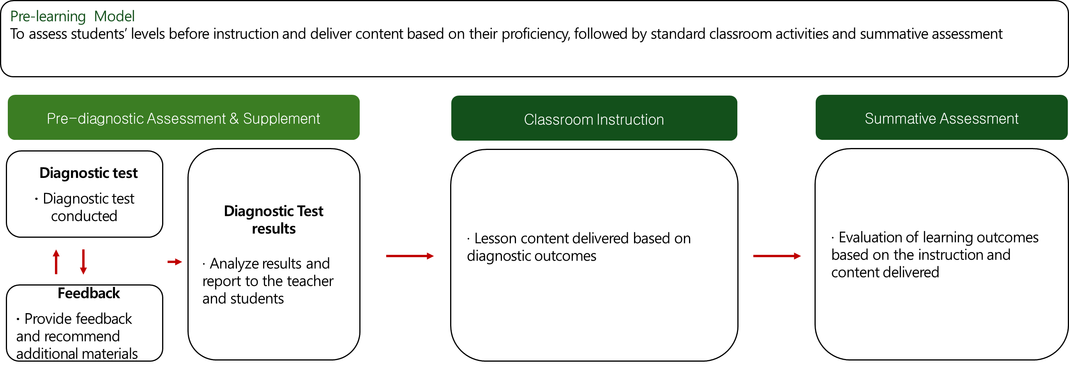
Concept-Based Inquiry Lesson Design Model Using AI Digital Textbooks
(Ministry of Education, 2024)

Slide 19
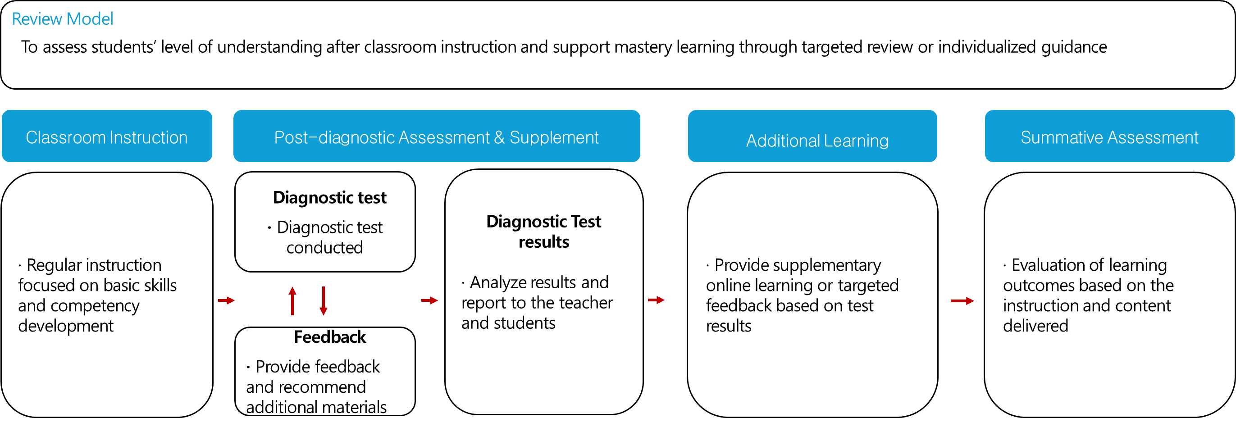
Concept-Based Inquiry Lesson Design Model Using AI Digital Textbooks
(Ministry of Education, 2024)

Slide 20
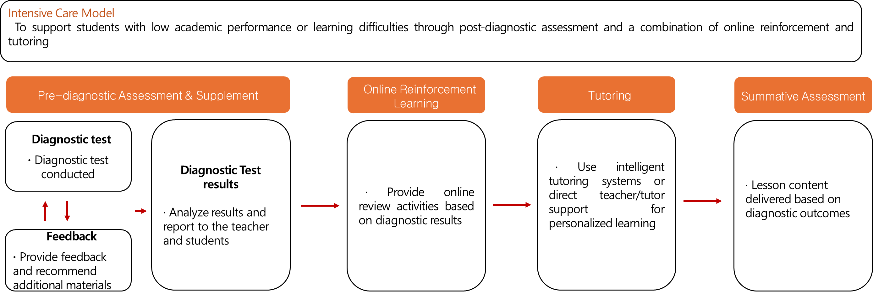
Concept-Based Inquiry Lesson Design Model Using AI Digital Textbooks
(Ministry of Education, 2024)

Slide 21
AI Courseware
A program developed to support effective English language learning for elementary school students
AI PengTalk https://pengtalk-student.ebse.co.kr
Argong English https://www.argong.ai

Slide 22
AI PengTalk
AI PengTalk has a positive impact on learners’ affective factors.
Over half of students and a significant portion of teachers viewed its feedback and meaning negotiation strategies favorably.
Students and teachers reported positive effects on self-directed learning, especially teachers (78.6%).

Slide 23
AI PengTalk Learning Modules
Module | Key Activities | Location
Vocabulary Learning Module | · Vocabulary study · Vocabulary games | Topic World
Sentence Learning Module | · Listen and repeat sentences · Expression practice (integrated reading and speaking)
Dialogue Practice Module | · Listen to the full dialogue · Listen and repeat · Speak first in a dialogue
Writing Module | · Arrange word spellings · Arrange sentence spellings · Sentence games

Slide 24
AI PengTalk Learning Modules
Module | Key Activities | Location
Dialogue Practice Module | · Listen to the full dialogue · Repeat · Listen and respond · Start the conversation first | Speaking
Dialogue Module | · Mission Talk (based on content from Topic World) · Situation Talk (based on Speaking content) · Free Talk (open conversation with Pengsoo) | Let's Talk
Free Conversation Module | · Topic-based free conversation | School Talk
Dictionary Module | · Object/image recognition functionality | Scan It
Assessment & Feedback Module | · View my assessment (for learners) · Listen to my recordings (for learners) | Topic World
 | · View learning progress by grade/class (for teachers) · View individual learning status (for teachers) | Statistics

Slide 25
Teaching and learning methods using AI PengTalk
Vocabulary learning, expression learning
Pre-class activities, in-class activities, and after-class activities for student self-directed learning, etc.
At the teacher's choice, only in-class activities are given a certain amount of time
to use certain features of AI PengTalk.
Assignments as self-directed learning activities only after class
Flipped Learning

Slide 26
Wrapping up
AI digital textbooks, equipped with intelligent AI tutor functions, serve as "slightly smarter" instructional tools.
If used appropriately and in accordance with educational contexts, they can help achieve the intended positive outcomes.
To effectively utilize AI digital textbooks in English education, it is necessary to refer to general instructional models, and selectively apply their functions during pre-learning, classroom instruction, and review, based on learning goals and student needs.

