Slide 1



Tachers Association of the Republic of Indonesia (PGRI)
Educators: Humanizing Education
Amidst Rapidly Changing Landscapes
Ifan Iskandar
ASEAN Council of Teachers (ACT) + 1 Convention. the 39th Baguio City, Philipines, Friday-Sunday, 19-21 September 2025

Slide 2

Flow of Ideas
❑
The world we’re dealing with: the rapidly changing landscapes and entry points for re/humanizing education
Pedagogical focuses and vision of knowledge in
humanizing education
Challengesand measures to humanize curriculum
and education
Re/humanizing education in Indonesia
❑
❑
❑

Slide 3


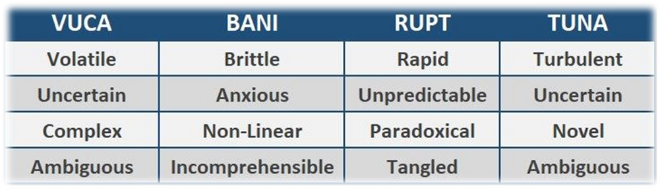
The world we’re dealing with: the rapidly changing landscapes
and entry points for re/humanizing education
“In any given moment we have two options: to step forward into growth or step back into safety.” —Abraham Maslow
Terms that reflects dynamics of ever changing (Clegg et al., 2019; Zakharov, 2022; Kozielski, 2023); and used to understand the nature rapid changing (Gandhi, 2017; Sinha & Sinha, 2020; Mielkov, 2020).

Slide 4

The dynamic world we’re dealing with
3
IBM Watson: legal consultation done in secondswith 90%accuracy (human 70%) 90% lawyers are no longer needed
China:pavilion6storey24hours;hotel
5
15storey 6 days in 2010; hotel 30 storey 355 rooms 15 days, in 2011 earthquake resistance in 7-9 Richter
during C-19, 83 % can be done at home; in the US
1
Knowledge abundance
Artificial intelligence
Work/studyfrom
3-D printing
home
now 37% (Dingel &
Neiman, 2020)
… it is the analysis, evaluation and application of knowledge to solve problems that has taken center stage. (Salgues, 2018)
7
Fragmented flow of
1
3
5
7
supply from producer to
consumer
8
Home-based
restaurant: producer, mediator, and deliverer
2
4
6
8
Rapid development
Digital Native
Job dynamism
2
of knowledge
65% primary school students will deal with non-existent jobs. (WEF, 2016); 97 mil job emerge & 85 mil submerge; pada 2025, 50% workers need reskilling, 40% core skills change (WEF, 2020) (Deskilling, Reskilling, Upskilling)
Doubled in 100 years before 1900;
doubled in 1 year(Prensky 2009). Doubled in 12 hours (2020)
“live with gadgets, multi-tasking, suffer from cyber laziness to anti-
6
social symptoms &
self-exclusion
4
from physical reality (phubbing) (Vitvitskaya et.al., 2022)

Slide 5




The challenges …
2016 was the warmest year
(NASA & NOAA)
;2023 was the warmest year (
NASA & NOAA January17, 2024;
The 10warmest years inthe 174-year record havealloccurred during the last decade (2014–2023)
https://www.climate.gov/news-features/featured-images/2023-was-warmest-year-modern-temperature-record#:~:text=Details,decade%20(2014%E2%80%932023).
1. Health
: Globally, warming of 2-3 C causes >150 millionadditionalcases of malaria.
°
By 2030, a number of 48,000 more diarrhoea-related deaths in children under 15.
:The crop yield failures is projected to be as much as 4.5 times higher by 2030
2. Hunger
andup to 25times higher by 2050across globalbreadbaskets.
3. Waterscarcity
: By 2025, 1.7 of 5 billion people on the planet are affected by water scarcity.
4. Education
: economic downturns force families to put their children to work, not school work.
5. Creatingrefugees
: By 2050, 216 million climate refugees will have been displaced in six world regions ( the
top three are in sub-Saharan Africa, East Asia and the Pacific, South Asia.
6. Work-relatedhazards
: Excessive heat restricts a worker’s physical functions and capabilities, work capacity
and productivity (reducing total working hours worldwide by 2.2% and global GDP by $2.4 bil in 2030.
https://www.climate.gov/news-features/featured-images/2023-was-warmest-year-modern-temperature-record#:~:text=Details,decade%20(2014%E2%80%932023). https://www.worldbank.org/en/topic/climatechange/overview

Slide 6

Line of Age…
1.The DarkAges
What comes next, and when does it start?
2. The Renaissance
Some potential trends and directions that could shape the future:
1. 2. 3. 4. 5. 6. 7. 8.
Age of Artificial Intelligence (AI); Age of Automation and Robotics; Age of Sustainability; Age of Biotechnology and Genetic Engineering; Age of Virtual and Augmented Reality; Age of Quantum Computing; Age of Connectivity and Interplanetary Exploration; Age of Ethical and Philosophical Reflection
3. The Age of Enlightenment
4. The Information Age
5. … (What comes next, and when does it start?
TeachThoughtStaff. https://www.teachthought.com/the-future-of-learning/what-comes-after-the-information-age/

Slide 7

Entry points for re/humanizing education
➢
Human livesare evidentlylackof equanimityor“theability to nurture grace during challenging
times” (a calm mental state, after shock or disappointment) (Lyle, 2022):
we often re/turn to the mother nature to console ourselves during difficult times (Lyle, 2022);
“We cannot exist outside of our relationship on and to the Earth—our humanness is
quintessentially linked to our home planet” (Arendt’s,1958):
Eurocentric thinking formed the backbone of curriculum and pedagogy
➢ ➢
➢
(Lyle, 2022);
➢
The cognitive imperialism in Canadian schooling is posited on the fallacious assumption that European values (western in general), morals, and ways of knowing were superior to those of Indigenous peoples (Marie Battiste, 2013),

Slide 8


Entry points for re/humanizing education
❑
The male,White, Eurocentric foundational theorists like Piaget, Vygotsky,
and Erickson have been continously (re)create established structure of child development, universalizing it, and normalizing certain childhoods (Burman, 2008; Canella, 1997; Viruru, 2007 in Creating a Sense of Belonging in Early Childhood Studies Nidhi Menon, 2022);
❑
Wehavebeendehumanisedandthushumanityisneeded
and we
(Freire, 2000)
also believe that dehumanizing practices in academia
(Khoza-Shangase, 2019, p. 43);
❑
Education is dominated by the dehumanizing factory model in which social skills, self- exploration, and making connections with others are fading (Eisner, 2002); banking model of education (Paulo Freire (1970) in Provenzo, 2006; Smith, 2002); the teacher as the active participant (making deposit) and the students as passive objects (receive, memorize, and repeat the knowledge); Dehumanization manifests itself in social inequities, racism, sexism, ableism, ageism, and so on
(Cho, Corkett, and Pitcher (2022) in Lyle, 2022)
❑
❑

Slide 9


On re/humanizing education …
✓
theprocessofbecomingmorehuman associal, historical, thinking, communicative, transformative
creative persons who participate in and with the world through Culturally Relevant Pedagogy . (Cho, Corkett and Pitcher, 2022, infered from Freire’s 1970) (Freire, 1984); treasures students as active members within the learning process (Mahani (2022) in Lyle, 2022); re/humanizing approach is developed through a complexity theory, which “aims to understand the whole by understanding the interaction of its parts” (Phelps & Hase, 2002, p. 510); concetrating on relationships and the intricacies of interconnectedness (Mevawalla, 2013);
✓ ✓

Slide 10


On re/humanizing education …
✓
emphasizesdialogicallearningthatvaluesstudents as co-creators of knowledge and encourages
criticalreflection,empathy,and agency (Sheridan,2018); becomes increasingly critical to ensure learners develop not only cognitive and technical skills but also emotional intelligence and social responsibility (Kress & Lake, 2018; Magro et al., 2020);
✓
✓
emphasizing on care as a foundational element in teaching and learning relationships to cultivate trust,
empathy, and emotional safety within classrooms in reinforcing holistic student development (Nel Noddings (2022) in Mondal & Ghosh, 2025; Yadava, 2017); understanding the condition of being human—our humannes is inseparable from our existence on the Earth and our relationship with other humans (Arendt, 1953 in Lyle, 2022)
✓
Knowledge is of no value unless you put it into practice. Anton Chekhov

Slide 11


Pedagogical focuses in humanizing education
❖ ❖
Centered around the students’ lived experiences (Mahani in Lyle, 2022); Aiming to develop critical consciousness through a dialogic approach
(Freire, 1972)
to cultivate students’ agency so they can co-construct their learning Elbow, 1994); Admitting the importance of cultural diversity and the incorporation of students’ intersectionality utilizing cultural and linguistic artefacts in the curriculum and teaching resources (Ladson-Billings, 1995) Employing culturally relevant pedagogies to accelerate humanization in
(Bartolomé;1994;
❖
❖
education
.
(Samaras, A. P., & Freese, A. R., 2006)

Slide 12

Vision of knowledge in humanizing education
❑
knowledge “where the relationship with something (a person, object, or idea) is more important than the thing itself” (Wilson, 2020);
knowledge is revealed as a telling of a story in community (Boje, 2001)
students’ and teachers’ lives, world, and self-identification beyond school is
undeniably central to learning to attain further awareness of the stories
relatedness (Donald, 2019)
“in growing our awareness of our kinship, we grow in our awareness of our
responsibilities” (Crawford, Hill, Dykema, Hiltermann, Tata and Wong (2022) in Lyle, 2022)
❑ ❑
❑
Relational thinking also implies a responsibility—a duty of care to maintain good relations and to keep things in balance (Lyle, 2022)

Slide 13


Challenges to humanize curriculum and education
✓
The standardization of curriculum and evaluation in the educational design and delivery in the 20th century (Leddy, 2022);
The dominance of democratic education in which each student should receive the same educational
content and opportunities (Donald, 2020)
Educator emphasize on creating homo economicus with the orientation to unlimited growth and material
prosperity (Donald, 2020)
Modern life of a 24-hour world brings about the depth of the loss of connection (likes and followers are
✓
✓
✓
more valuable than personal growth and values; connectivity are more important than connection)
(Leddy,
2022)

Slide 14

Measures to humanize curriculum
❖
incorporating the exchange of ideologies, sharing of histories from various angles, and critical engagement and awareness in and of a shared world (Greene, 1995 in Khan, 2022). Infusing a relevant cultural framework to localize and humanize the curriculum” (Burke et al.,2008)
❖ ❖
incorporating the diversity of cultural, religious, historical, and social realities to construct affirming,
inclusive, equitable, and justice-oriented curriculum creating safe sharing spaces in curriculum and classrooms for students’ lived struggles, fears, and realities changing the students’ role from the listeners to be learners by creating space for counter-narratives in the curriculum to balance “narratives of dominance called majoritarian stories” (Hunn et al., 2006)
❖
❖

Slide 15

Measures to humanize curriculum
❖
reframingcurriculum-as-livedratherthanaplanned curriculum that pre-plans teaching and learning (Aoki, 2005);
curriculum design utilizing transformative frameworks (Egbo, 2009 in Sivia, Sidhu and Levings, 2022)
replanning curriculum as a problem-posing one in which education involves interrogating, disrupting, and
reframing knowledge and knowing (Sivia, Sidhu and Levings, 2022)positioning students and teachers to become
agents of change through their involvement in social justice projects and community outreach (Mirra and
Morrell, 2011)
Designing curriculum by the inclusion of lived realities,culturally distinct worldviews, and diverse
❖ ❖
❖
expressions of being which form a constellation of personal and social experiences
(Gay, 2013)
❖
Transforming the Eurocentric curriculum and standards-driven teaching into a curriculum that deliberately admit socio-political issues such as power, privilege, and oppression of marginalized, racialized peoples (Dei, 2008; hooks, 2004; McIntosh, 1994).

Slide 16


Measures to humanize education
➢
employinga culturally relevantapproachthat maintain the students’ values,
backgrounds, and beliefs (Bartolomé, 1994) (cultural competence) and engaging the development of critical perspective by challenging injustice (sociopolitical consciousness) (Ladson-Billings, 1995)
➢
viewing education as an experiential journey and avoiding the conceptions of
schooling different from students actual ordinary lives (Battiste, 2013; Cajete, 1994; Little Bear, 1999; Ingold, 2017).
making our students ready not for the world as it was, but for the world as it is and
will be (Dewey, 1934)
creating learning environments in which all participants become co-creators of
knowledge (Freire, 1986)
enabling a Humanizing Pedagogy of Mindfulness—a mindful approach focuses on
engagement and personalization based on each person’s unique gifts (Holmes, 2022)
➢
➢
➢

Slide 17

Measures to humanize education
➢
Reinvisaging schoolingwithhumans relationships to one another and to all of the
Earth itself, and the responsibilities those relationships imply (Lyle, 2022)
➢
Recognizing what it means to be a good person and live in good ways beyond
the eyes of in the Europe and the Northern hemisphere (Donald, 2020)
Employing four teacher relational actions that are “relationships with the student,
relationships among students, connection to process, and connection to content”
(GouletandGoulet,2014)
➢
➢
Including Indigenous teaching strategies that are “holistic focus [on] individual,
family, community, and natural world…experiential, participatory, and active based learning…[a] ‘See & Do’ mentoring approach…[and] exploration, play, creativity, and lifelong learning” (Michell, 2018); utilizing reflexivity—“consistent conscious examination of one’s own professional and personal biases, values and experiences” (Creswell, 2006)
➢

Slide 18

Measures to humanize education
➢
adopting critical social justice leadership (DeMatthews, 2015; Theoharis, 2007)—a problem- seeking approach to leadership where equity and inclusion are goals to work towards
(Safir, 2017; Theoharis, 2007)
Addressing education more than schooling—seeing on the impacts of pedagogy and
curriculum on students’ perception of self and their self-knowing (Sivia, Sidhu and Levings, 2022)
Employing W(H)olistic pedagogies that progress the flourishing of the mind, body,
spirit, and emotions of the learner and teacher, honouring all dimensions of being,
family, community, and ecology (Kelly, 2021) applying contemplative pedagogy—meaningful education through four integrated
aspects: meaningful, experimental, relational, and of substantial content (Cohen, 2015;
Holmes,2022)
➢
➢
➢
➢
fostering empathy in educational settings can enhance students’ capacity for critical
and creative thinking, making them more reflective and socially aware learners 2022);
(ZhouDr,

Slide 19
Measures to humanize education
➢
operatinghumanism-focusedapproaches,suchasinquiry-based and problem-based
learningallowinglearnerstodevelopboth cognitiveandemotionalskillsnecessaryfor 21st-century challenges (Novikova et al., 2024); adopting deep learning to engage students cognitively, emotionally, and socially, fostering not only knowledge retention but also critical thinking, creativity, and personal
➢
growth
(Bursicet al.,2020)
➢
nurturing a sense of social responsibility and ethical citizenship (Cornelius-White, 2007; García-
Moya et al., 2019)
using Freire’s problem-posing approach inviting learners to question, reflect, and act
on their realities (Chalaune, 2021; Da Costa, 2024)through conscientization—the process of
developing critical awareness that enables students to identify and challenge social
injustices (Lodge, 2021);
emphasizing on the key principles of humanizing education—empathy, dialogue, and
learner-centeredness—serve as the foundation for fostering meaningful and
transformative learning experiences that place human relationships at the heart of
education
➢
➢

Slide 20

Re/humanizing education in Indonesia
❑
FreedomtoLearnandCampusofFreedom
The initiative of (Merdeka Belajar dan Kampus Merdeka
began in early
2020) aiming to empower students and educators with greater autonomy, flexibility, and opportunities in learning landscapes by employing student-centered learning,
interdisciplinaryprojects,andreal-worldproblemsolvingto
prepare learners for complex global challenges (Fitramadhana, 2023; Putri, 2021).
❑
The Student Profile of Pancasila (Profil Pelajar Pancasila
commenced in 2020) of a vision for holistic student development by embedding values of independence, collaboration, critical thinking, and cultural literacy as intended learning outcoms in curriculum and assessment systems (Khatimah et al., 2025; Palangda et al., 2023) assurig that learning is not only intellectually rigorous but also socially and culturally grounded (Amreta & Anisah, 2023);

Slide 21

Re/humanizing education in Indonesia
❑
at the primary education level (SD), curricula should emphasize the development of empathy, cooperation, and moral reasoning through thematic and holistic learning approaches and collaborative and reflective activities (Safitri & Rahim, 2024); at the secondary level (SMP/SMA), reflective practices and collaborative projects are carried out to foster students’ ability to critically engage with complex issues and to cultivate independent learning and character development (Handayani et al., 2024); at the higher education level (Perguruan Tinggi), curricula must promote transformative learning experiences challenging students to question assumptions and develop personal and social responsibility through interdisciplinary and experiential learning (Edi et al., 2024). The national policy of employing of deep learning to re/connect academic content to students’ lived experiences and values, making learning both meaningful and transformative. Mobile and digital platforms, increasingly adopted in Indonesia to enable blended and flipped classroom models that foster critical engagement (Ansori et al., 2024).
❑
❑
❑

Slide 22
Re/humanizing education in Indonesia
❑
Mandatory local contentinthecurricula ofprimary and secondary education—local content must contain the
characteristics of local (municipalities or provinces) culture, skills, customs, ethic, wisdom, and social and ecological issues (Ministry of National Education, 2004, 2006, 2007). Local wisdom menifesting itself in the forms of knowledge, beliefs, understandings, insights, customs, and ethic are developed in the proses of indigenization (indiginasi)—making use of local culture in the learning courses to bring students closer to their surroundings and thus make learning process meaningful (Muslich, 2007:50). Indonesia has 1,728 intangible cultural heritage of 11,622 cultural heritage (Culture Directorate Protection of Ministry of Education, Culture, and Technology, 15 December 2022) and 300 ethnic groups and 1,340 tribes (BPS 2010; Suku Bangsa Administrator Minggu, 3 Desember 2017 | 05:58 WIB Indonesia.go.id) Ecotheology campaign by Ministry of Religious Affairs (launched in March 2025) in order to promote the endeavours to search for solutions to ecological crises involving human resources in the Ministry including all pertinent educational institutions—87,397 schools and 907 universities. In Indonesian primary schools (SD), activities such as circle-time discussions and story telling are conducted to encourage young learners to express ideas and listen actively to peers and the activities significantly improve socio-emotional growth (Kalifah et al., 2024). At the secondary level (SMP/SMA), problem-based learning (PBL) and debate formats have been applied to develop teamwork, negotiation skills, and critical perspectives on community issues (Sajidan et al., 2022).
❑
❑

Slide 23


Re/humanizing education in Indonesia
(transformativecompetencies&transferrableskills(Bappenas, 2023)
Transformative Education
aimsdecisivelytotransformthe world of education and to nurture the next generation
to become problem-solvers and creative thinkers
,empowered with the necessary skills to make this world a
better place.
Transformative competencies:
✓
✓
✓
creating new value (
innovating to shape better lives, e.g. creating new jobs and developing new knowledge);
reconciling tensions and dilemmas(
taking into account the interconnections and inter-relations between
contradictory or incompatibleideasandpositions);
to reflect upon and evaluate one’s own actions in light of one’s experience and education)
taking responsibility (
Transferable skills
knowledge, experiences, and abilities that you take with you from one job to another, even
when you're switching roles or industries (Critical Thinking, Problem Solving, Adaptability,
Teamwork, Attention to Detail, and Management)
Abiko, T. (2019). OECD future of education and skills 2030; OECD. (2019). An OECD learning framework 2030 (pp. 23-35). Springer International Publishing.
Transferable Skills: How to Use Them to Land Your Next Job, Written by Coursera Staff • Updated on Feb 2, 2024 https://www.coursera.org/articles/transferable-skills

Slide 24










Re/humanizing education in Indonesia
Development Method of Integrated Competence
10%
1. Critical Thinking 2. Communication 3. Compassion and Civic Responsibility 4. Computation Logic 5. Creative Thinking 6. Collaboration
Formal Learning
(training & self-study)
The-21 Century Skills (HOT: 6Cs)
20%
Social Learning
(feedback,coaching,mentoring
Three New
Literacies
70%
Experiential Learning
Data
Technology
Human
(project assignment, special assignment, on the job teaching, task force assignment, rotation)
Literacy
Literacy
Literacy
Source: Assignments -Other People -Coursework: Comparison Six Lessons of Experience Studies by Cynthia McCauley Center for Creative Leadership -2013
Panduan Penyusunan Kurikulum Pendidikan Tinggi Mendukung Merdeka Belajar-Kampus Merdeka Menuju Indonesia Emas, Direktorat Jenderal
Pendidikan Tinggi, Riset, dan Teknologi 2024

Slide 25


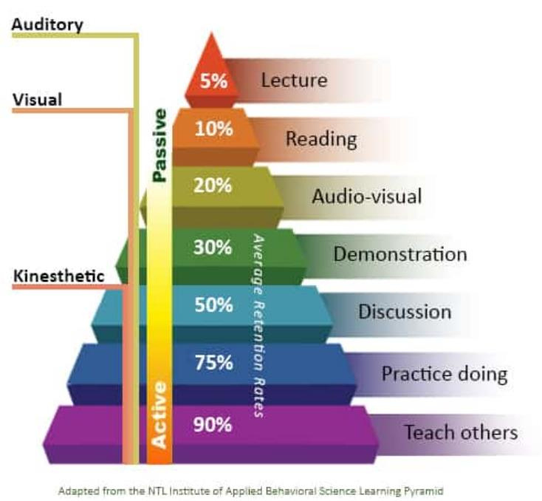
Learning pyramid and humanizing education

Slide 26




focusing on the teacher-studentrelationshiptocultivatestrong,positiverelationshipsbetween
01
teachers and students, based on trust, respect, and empathy
recognizing students' emotional and social well-being for creating an atmosphere
02
where students feel safe, supported, and valued
applying inclusivity and equity in dealing with the students’ diverse
03
needs & challenges to promote a more equitable learning space
On re/humanizing education …
concentrating on the holistic development of students' social, emotional, and intellectual capacities, not solely on academic
04
achievement
employing authentic learning that are relevant, meaningful, and
engagingthat connect learningto their livesand experiences
05
Benefits of Humanizing Education: 1) Increased Student Engagement and Motivation; 2) Improved Academic Performance: 3) Development of Essential Life Skills: 4) Positive School Culture: 5)
Long-Term Impact

Slide 27


“All things are animate and, therefore, we are a relative of all things. If we really understood the Earth as our Mother, would we be so quick to enact rapacious extractions upon her body? If we understood the Water as our Cousin, would we continue to poison it and choke its pathways? And if we understood each person on the planet as our relative, would we not care for them as we care for, and are cared for, by our own nearest and dearest?” (Leroy Little Bear, 1999 in Lyle, 2022)

Slide 28

Thank you
Maramingsalamat po

